Slide 1
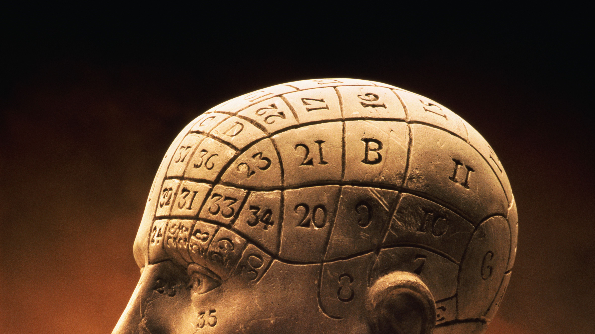
The dark tetrad and message vividness: implications for the persuasiveness of terrorist narratives
DR. KURT BRADDOCK- THE PENNSYLVANIA STATE UNIVERSITY
DR. PAUL GILL & DR. EMILY CORNER- UNIVERSITY COLLEGE LONDON
MEETING OF THE SOCIETY FOR TERRORISM RESEARCH
14 AUGUST 2017

Slide 2
overview
Basis of the study
The Dark Tetrad
Interaction with message vividness
Methods and steps forward
Predictions

Slide 3

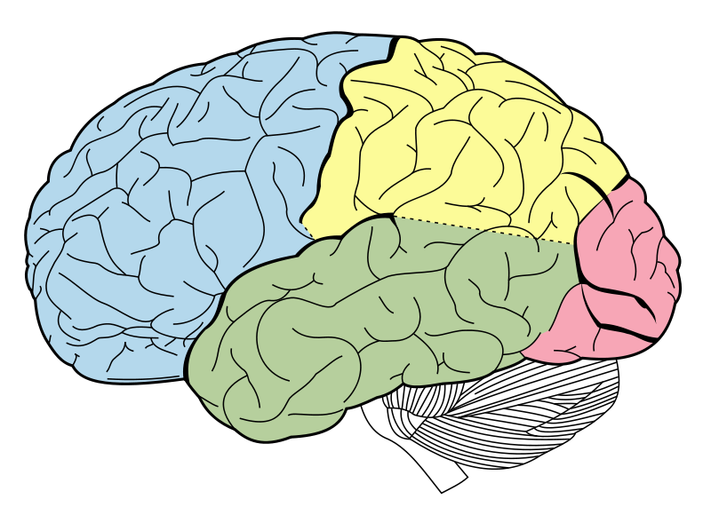



The dark tetrad: basis
Driving question: Some individuals are prone to persuasion by terrorist propaganda? Why?

Slide 4

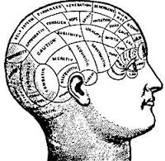
Basis for studying narrative persuasiveness and terrorism
Early research on terrorism and personality
More contemporary work on terrorism
Research on communication and terrorism
  Terrorist messaging can contribute to the adoption of extremist beliefs/attitudes (Braddock, 2012, 2015; Braddock & Dillard, 2016)
  Message content and style interacts with individual-difference variables
    Sensation-seeking (Zuckerman, 1979, 2014; Donohew et al., 2000; Stephenson & Palmgreen, 2001)
Do certain types of terrorist messages appeal to certain individuals?

Slide 5

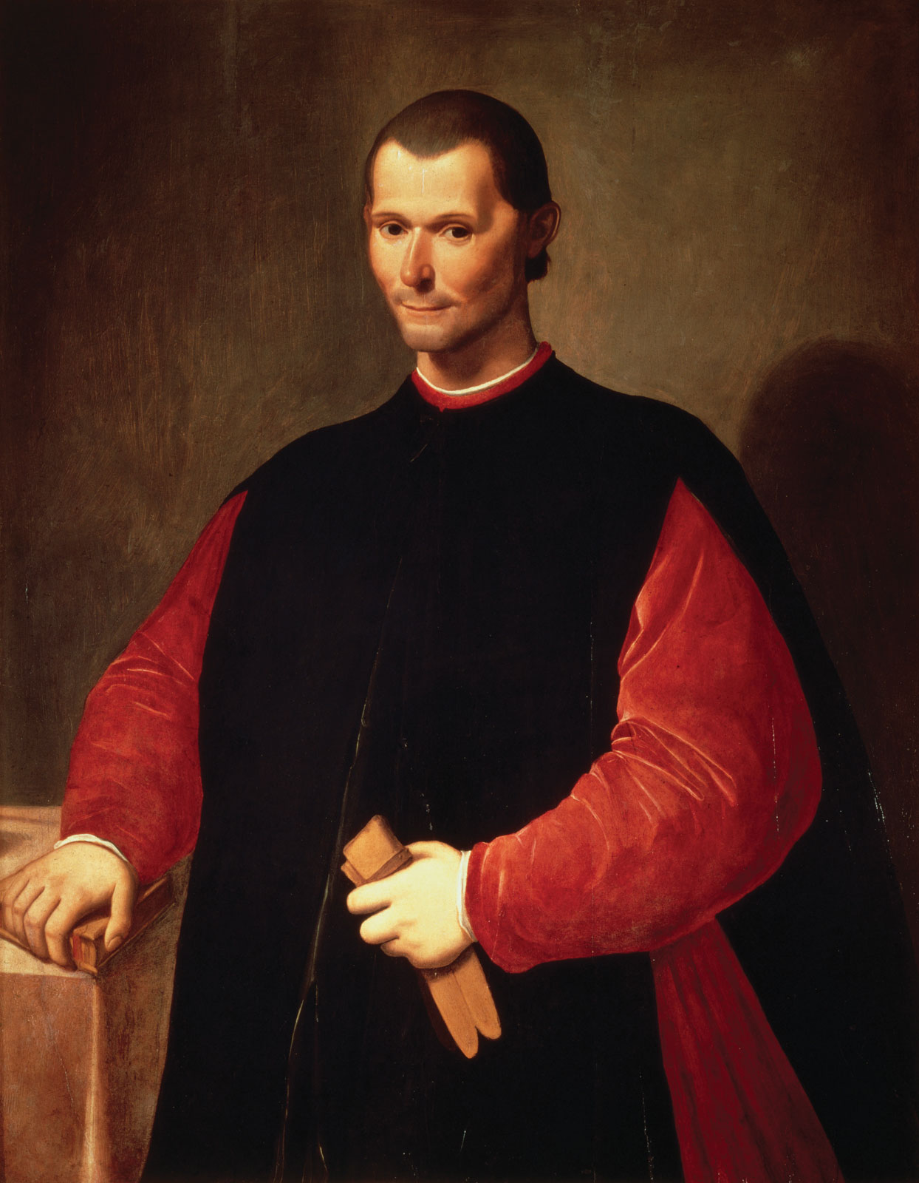

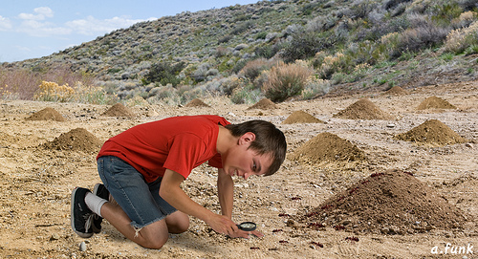
Personality factors: the dark tetrad
The Dark Tetrad – Four personality traits linked to negative outcomes (e.g., bullying, racist attitudes) and sensation seeking
  Narcissism – Grandiose identity and underlying insecurity
  Machiavellianism – Predisposition to use others as tools for self-gain
  Subclinical psychopathy – Impulsivity or thrill-seeking coupled with a lack of empathy or how actions affect others
  Everyday sadism – Enjoyment in witnessing forms of cruelty to others

Slide 6
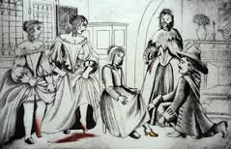
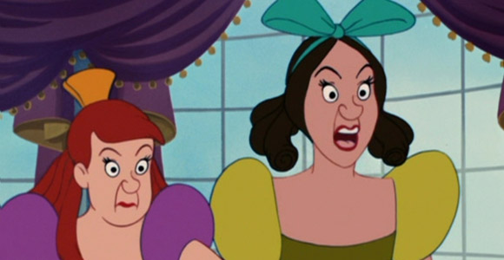
Interaction with Message vividness
Message vividness – The degree to which a message is specific about individuals, their actions, the contexts in which the actions occur, and the actions’ outcomes in a narrative
  Affects the persuasiveness of stories for different individuals
  High sensation-seekers
  High need-for-cognition

Slide 7
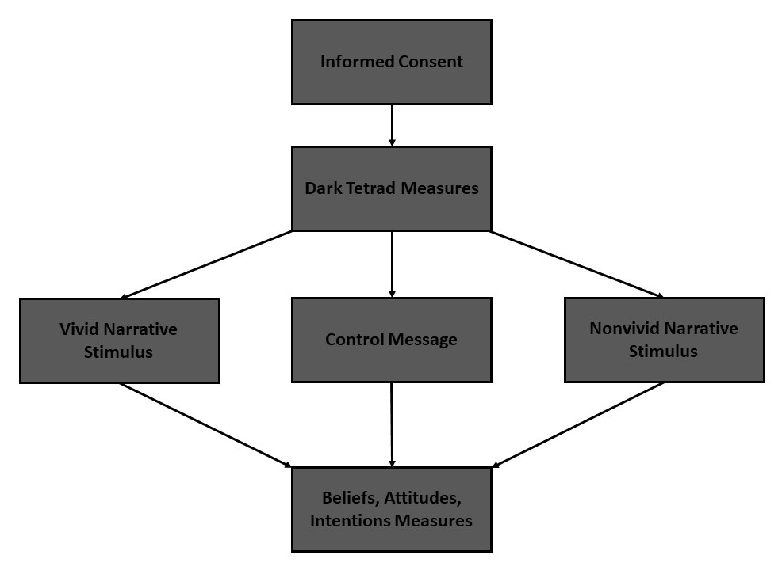
The dark tetrad and terrorist narrative persuasiveness
Methods
  Between-subjects experimental design (N = 350)
  Vivid vs. nonvivid conditions – narrative stimuli derived from the “Cerbenia Freedom Alliance” (Hamas source)
Narcissism, Machiavellianism, subclinical psychopathy – Short Dark Triad (SD3; Jones & Paulhus, 2014)
  All α > 0.72
Everyday sadism – Short Sadistic Impulse Scale (SSIS; O’Meara, Davies, & Ajzen, 1975)
  α > 0.75
Outcome variables: Beliefs, attitudes, and intentions in relation to the “group”

Slide 8
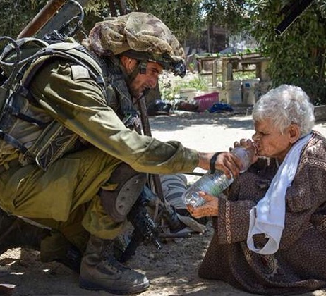
Narrative stimulus
Nonvivid | Vivid
During the invasion of 2015… | During the bloody invasion of 2015, under the sounds of deafening bombardment…
She was scared, but refused to leave… | She was terrified and trembling, but refused to leave…
The woman had been dead for hours… | The woman died hours before, her blood having drained onto the street in small puddles that dried to gel…

Slide 9
Belief, attitude, and intention measures
Beliefs | Attitudes | Intentions
It seems as though the invaders are stealing land from the CFA’s home country. | The attacks carried out by the CFA are justified. | If given the opportunity, I would protest the CFA’s enemies.
The CFA’s attacks are likely to lead to the changes the group hopes for. | If the government can’t protect its citizens, the CFA has a duty to do so through their attacks. | If given the opportunity, I would raise money for the CFA.
It doesn’t sound like political solutions are going to help the CFA achieve its goals. | The CFA has a right to defend itself and its country. | If given the opportunity, I would consider using deadly force against the CFA’s enemies.

Slide 10
the dark tetrad: predictions
Main effects of the Dark Tetrad
  H1: Narcissism → Persuasiveness of a terrorist narrative (+)
  H2: Machiavellianism → Persuasiveness of a terrorist narrative (+)
  H3: Subclinical psychopathy → Persuasiveness of a terrorist narrative (+)
  H4: Everyday sadism → Persuasiveness of a terrorist narrative (+)
Interaction effects with narrative vividness
  H1 – H4 more pronounced in vivid condition relative to nonvivid condition

Slide 11
Implications for design and distribution of counter-propaganda
  Direct effect: Dark Tetrad → Persuasion by terrorist narratives, independent of vividness
    New evidence related to personality and proclivity for radicalization (not terrorism)
    Imbue counter-narratives with similar features to appeal to tetrad traits
  Interaction effect: Dark Tetrad x Vividness → Terrorist narrative persuasiveness
    Imbue counter-narratives with features that appeal to sensation-seekers
    Distribute counter-narratives through channels that appeal to sensation-seekers

Slide 12




contact
kurtbraddock@psu.edu
@KurtBraddock
kurt.braddock
www.linkedin.com/in/kurtbraddock

